Slide 1
Breast Cancer Identification
Padala Vijay Reddy
Madabathula Venkata Sai Pavan
D Karunakar Rao

Slide 2
Today’s Agenda
Problem Statement
Data set
Steps used to solve the problem
Results
Statistical Test
Conclusion

Slide 3
Problem Statement
Predicting whether the cancer is benign or malignant
About Breast Cancer:-
Breast cancer is the second most leading cancer occurring in women compared to all other cancers. Around 1.1 million cases were recorded in 2004. Observed rates of this cancer increase with industrialization and urbanization and also with facilities for early detection.
The objective of this project is to apply multiple classification algorithms and be able to classify the test data.
Another Objective of this project is to increase the accuracy of the previous system which uses SVM which has its own disadvantages and more Visualization charts which makes us understand the problem well enough to make decisions about the issue.

Slide 4
Dataset
We have downloaded the dataset from Kaggle website , which is “Breast Cancer Wisconsin (Diagnostic) Data Set”
Link : https://www.kaggle.com/uciml/breast-cancer-wisconsin-data
About the dataset:
Features are computed from a digitized image of a fine needle aspirate (FNA) of a breast mass. They describe characteristics of the cell nuclei present in the image.
It consists of 32 columns with diagnosis
It has total of 569 entries with approximately distributed classes

Slide 5
Steps used for solving the problem
First importing the dataset into the project
Visualizing the data without cleaning, to understand the distribution of data.
Performing the required steps like Data Normalization, and preprocessing like filling the NaN values etc. to prepare the input dataset into required format
We calculated the importance of the features by using the RandomForest Classifier.
Then we applied the process of feature selection on the dataset from the support given by the RandomForest Classifier
We split the dataset into Training and Testing data in the ratio of 70% and 30%
Then we applied various Machine Learning Classification Algorithms like Decision Tree, Random Forest, Naive Bayes , KNN clustering
We compared the performance of different classification algorithms
Then we applied Statistical test to explain the goodness of the fit

Slide 6
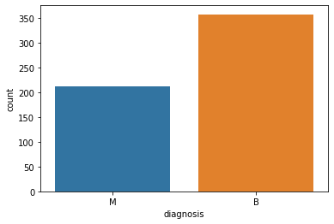
Visualization : Count Plot
Here , we can visualize the Count of Diagnosis with respect to the class variable. From this plot we can infer that the count of Malignant is 200 and Benign is around 350. The dataset is not biased. It is nearly populated with different class variables.
Generally , with these kinds of plots we can get the hold of our dataset.
i.e. The shape and the proportions with which the data is spread across.

Slide 7
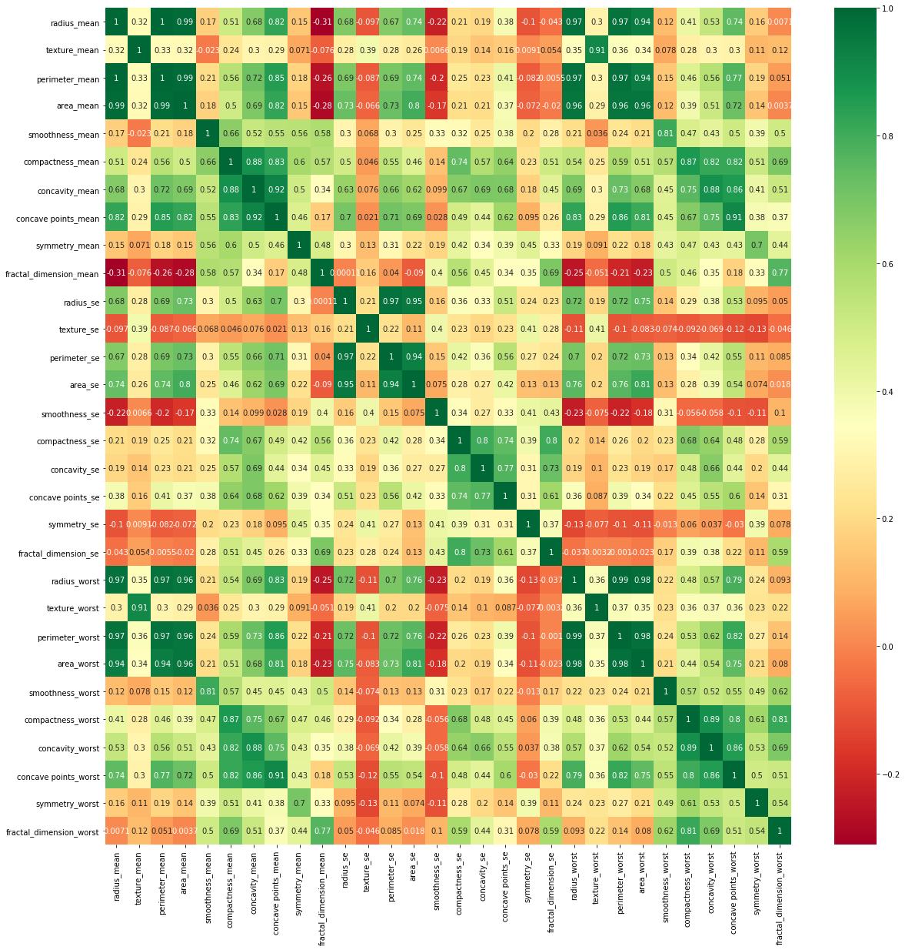
Heat Map
As we know, heat maps are great for making trends in the kind of data, where it is ordered and there is a possibility of clustering.
So , here we are trying to view the importance of two attributes with respective to each other.
The darker the value, the more the importance relative to each other.
The lighter the value, there is less importance relative to each other.
For Example:
Radius_mean with itself is darker where as radius_mean with texture mean is lighter.
So , we can say that correlation between those attributes is less.

Slide 8
Classification Algorithms applied:
We have applied different Classification Algorithms
They are:
Support Vector Machine (SVM)
Linear kernel
Rbf kernel
Naïve Bayes
Gaussian Bayes
MultiNomial Bayes
Decision Tree
Random Forest
KNN classifier
with neighbors = 2 to 20

Slide 9
Support Vector Machine (SVM)
“Support Vector Machine” (SVM) is a supervised machine learning algorithm which can be used for both classification or regression challenges.
In the SVM algorithm, we plot each data item as a point in n-dimensional space (where n is number of features you have) with the value of each feature being the value of a particular coordinate.
Then, we perform classification by finding the hyper-plane that differentiates the two classes very well.
The kernel functions are used to map the original dataset (linear/nonlinear ) into a higher dimensional space with view to making it linear dataset.
We have linear, rbf and Gaussian .
Usually linear and polynomial kernels are less time consuming and provides less accuracy than the rbf or Gaussian kernels
Advantages:
It works well with a clear margin of separation
It is effective in high dimensional space
Disadvantages:
it doesn’t perform very well, when the data set has more noise i.e. target classes are overlapping
It is more time consuming

Slide 10
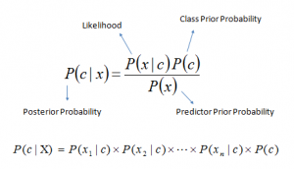
Naïve Bayes:
It is a classification algorithm based on Bayes’ Theorem with an assumption of independence among predictors.
a Naive Bayes classifier assumes that the presence of a particular feature in a class is unrelated to the presence of any other feature.
Naive Bayes model is easy to build and particularly useful for very large data sets. Along with simplicity, Naive Bayes is known to outperform even highly sophisticated classification methods.
If categorical variable has a category (in test data set), which was not observed in training data set, then model will assign a 0 (zero) probability and will be unable to make a prediction. This is often known as “Zero Frequency”.
Formula:-

Slide 11
Decision Tree:
Decision tree is a type of supervised learning algorithm (having a predefined target variable) that is mostly used in classification problems
In this technique, we split the population or sample into two or more homogeneous sets (or sub-populations) based on most significant splitter / differentiator in input variables.
Categorical Variable Decision Tree: Decision Tree which has categorical target variable then it called as categorical variable decision tree. Example:- In above scenario of student problem, where the target variable was “Student will play cricket or not” i.e. YES or NO.
Continuous Variable Decision Tree: Decision Tree has continuous target variable then it is called as Continuous Variable Decision Tree.
Advantages:
Easy to understand
Useful in data exploration
Less data cleaning required
Data type is not a constraint
Disadvantages:
Over fitting
Not fit for continuous variables.

Slide 12
Random forest:
Random Forest is a versatile machine learning method capable of performing both regression and classification tasks.
It also undertakes dimensional reduction methods, treats missing values, outlier values and other essential steps of data exploration.
It is a type of ensemble learning method, where a group of weak models combine to form a powerful model.
Advantages:
Can solve both regression and classification
the power of handle large data set with higher dimensionality.
It can reduce dimensionality
Disadvantages:
In case of regression, it doesn’t predict beyond the range in the training data, and that they may over-fit data sets that are particularly noisy.
rest can feel like a black box approach for statistical modelers – you have very little control on what the model does. You can at best – try different parameters and random seeds
We cant change algorithm to our needs .

Slide 13
KNN : k nearest Neighbors
K-nearest neighbors (KNN) algorithm is a type of supervised ML algorithm which can be used for both classification as well as regression predictive problems.
Lazy learning algorithm − KNN is a lazy learning algorithm because it does not have a specialized training phase and uses all the data for training while classification.
Non-parametric learning algorithm − KNN is also a non-parametric learning algorithm because it doesn’t assume anything about the underlying data.
Process:-
Step 1 − For implementing any algorithm, we need dataset. So during the first step of KNN, we must load the training as well as test data.
Step 2 − Next, we need to choose the value of K i.e. the nearest data points. K can be any integer.
Step 3 − For each point in the test data do the following −
3.1 − Calculate the distance between test data and each row of training data with the help of any of the method namely: Euclidean, Manhattan or Hamming distance. The most commonly used method to calculate distance is Euclidean.
3.2 − Now, based on the distance value, sort them in ascending order.
3.3 − Next, it will choose the top K rows from the sorted array.
3.4 − Now, it will assign a class to the test point based on most frequent class of these rows.
Step 4 − End

Slide 14
Results Obtained
Classifier Name | Precision | Recall | F1-Score | Accuracy
Logistic Regression | 94.5% | 92% | 97% | 94.3%
Gaussian Naïve Bayes | 88% | 87% | 96% | 94%
SVC Linear Kernel | 94% | 94% | 95% | 96.7%
Decision Tree | 90% | 89.4% | 96% | 91%
Random Forest | 95% | 96% | 95% | 95.34 %
KNN | 92% | 91% | 96.2% | 95%

Slide 15
Summary
Machine learning is an application of artificial intelligence (AI) that provides systems the ability to automatically learn and improve from experience without being explicitly programmed.
Machine learning focuses on the development of computer programs that can access data and use it learn for themselves.
The primary aim is to allow the computers learn automatically without human intervention or assistance and adjust actions accordingly.
Traditional programming is a manual process—meaning a person (programmer) creates the program. But without anyone programming the logic, one has to manually formulate or code rules.
In machine learning, on the other hand, the algorithm automatically formulates the rules from the data.

Slide 16
Datasets: A collection of instances is a dataset and when working with machine learning methods we typically need a few datasets for different purposes.
Types of Learning:
Supervised Learning:
Supervised learning is when the model is getting trained on a labelled dataset. Labelled dataset is one which have both input and output parameters.
Unsupervised Learning
Whereas when an algorithm learns from plain examples without any associated response, leaving to the algorithm to determine the data patterns on its own
Semi- Supervised
where an incomplete training signal is given: a training set with some (often many) of the target outputs missing.
Reinforcement
However, you can accompany an example with positive or negative feedback according to the solution the algorithm proposes comes under the category of Reinforcement learning, which is connected to applications for which the algorithm must make decisions (so the product is prescriptive, not just descriptive, as in unsupervised learning), and the decisions bear consequences.

